Slide 1
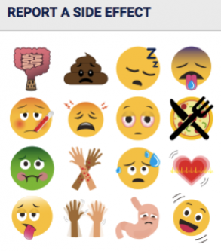
Adverse Effects
A Study of
Adverse Effects on Humans
for Variety of Products Made for
Human Consumption!
Prepared By:
Nimisha Patel
Data Analytics and Visualization

Slide 2

Hypothesis
With more and more processed foods and products in the market, we believe the number of adverse effects reported will climb with time.
Younger population is more prone to having adverse effects to food.
Gender difference should not make a difference.

Slide 3

Data Source and Data Repository
Data Source: The CFSAN Adverse Event Reporting System (CAERS)
A database that contains information on adverse event and product complaint reports submitted to FDA for foods, dietary supplements, and cosmetics.
Data Repository: http://www.Kaggle.com
Dataset was downloaded from Kaggle
.CSV Formatted Dataset
90,000+ Records

Slide 4
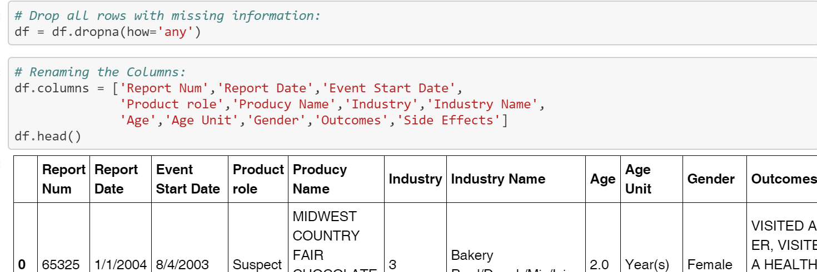
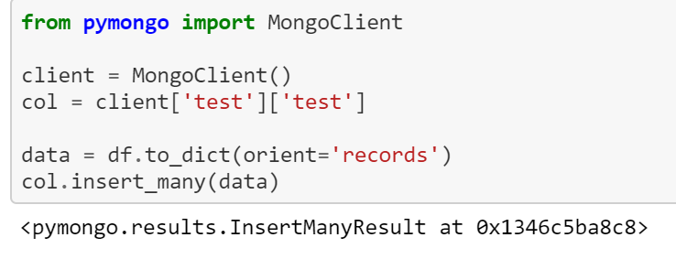

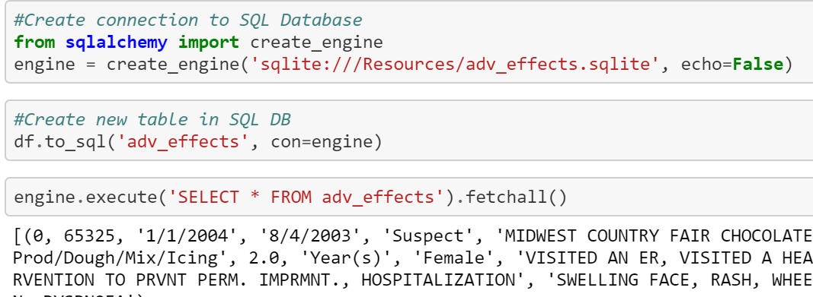
Data Transformation & Loading
Language and Libraries Used
Python
Pandas
Numpy
Matplotlib
Sci-Kit (SKLearn)
Data Loaded into:
MongoDB
SQLite
CSV

Slide 5
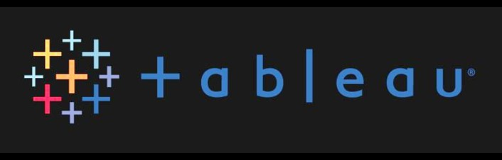
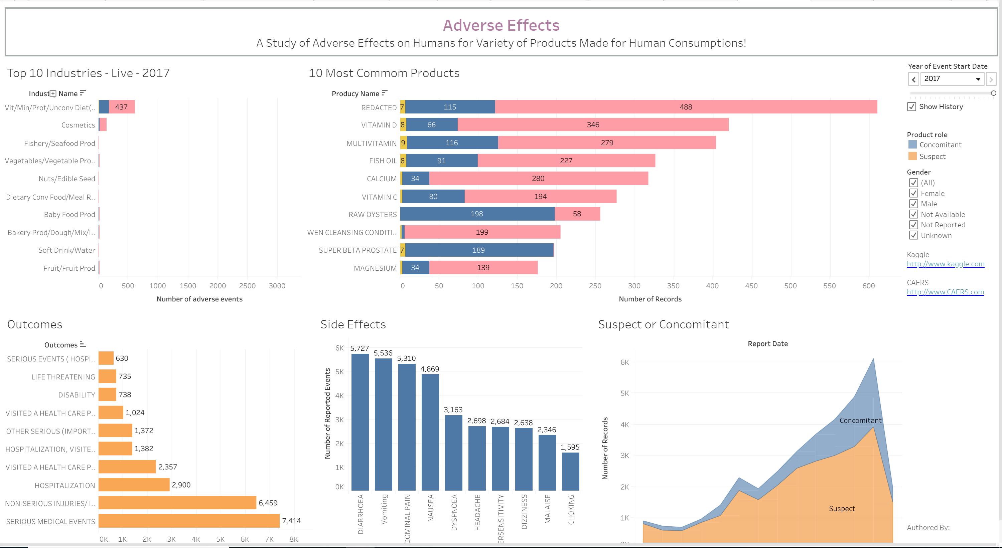
Data Visualization
Extensive Data Analytics (EDA) was Performed on the Data Set.
Tableau Desktop was used to Generate Visualization and Dashboard.

Slide 6
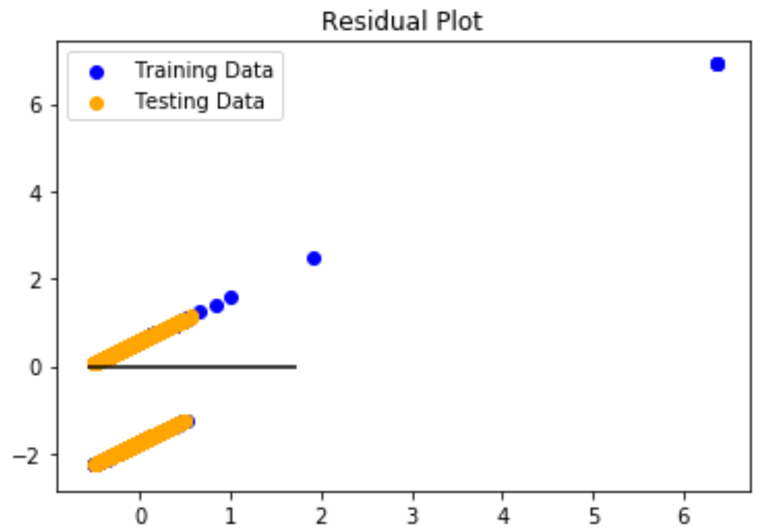
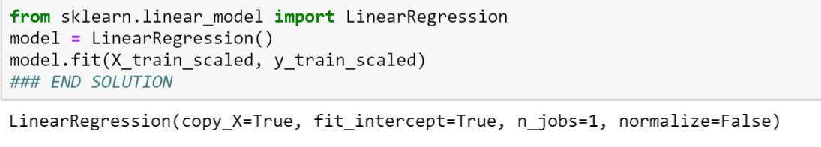
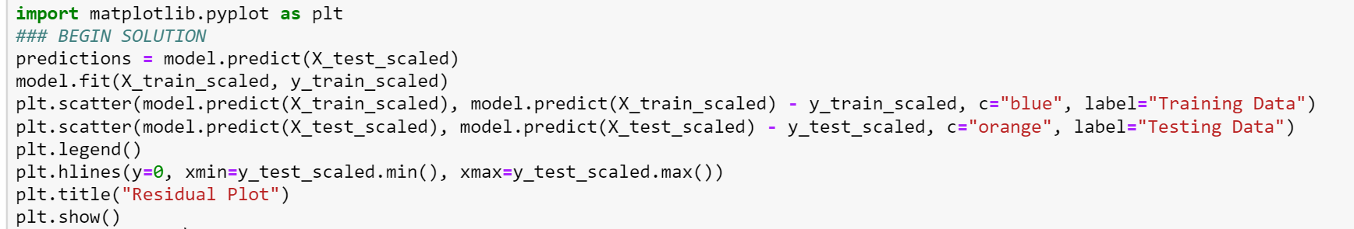
Machine Learning (Sci-Kit Library)
X-Values: Age, Gender
Y-Value: Product Role
Analysis:
MSE: 0.9451897170748137
R2: 0.051721555498203564

Slide 7
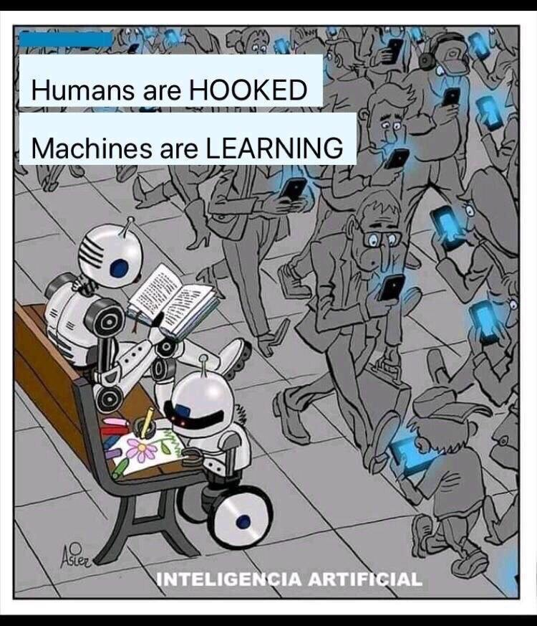
Artificial Intelligence / Machine Learning
Q&A

